Slide 1
4 Cs of Communication (Understanding the Communication Process)

Slide 2
Purpose of Written Communication
Written Communication
To persuade
To inform
To promote goodwill
To request
Notes:
Rarely does anyone write for professional reasons just for fun.
There must always be a good reason for writing an email, filling out a work order, or a composing a large market research report.
Knowing your reason for writing is essential to staying on track in the writing process.
Inform : Providing the necessary information to help receiver make decision or solve problem.
Persuade: Convince the receiver to take a recommended course of action.
Goodwill: create a good image of yourself and of your organization./Ensures the receiver walks away with a good opinion of the sender of information

Slide 3

Structuring & Paragraphing

Slide 4

Structuring
A well-structured text communicates the writer's intentions to the reader.
In such a text, the structure acts like a framework, in that it enables the material to be presented in a coherent and logical manner.
A text without structure, will lead the reader being lost or misunderstood.
Notes:
It is important to make sure writing is well structured.

Slide 5
Commonly Used Structure In Business Writing: PDA
Purpose
Detail
Action

Slide 6

Understanding the Communication Process

Slide 7
The Four Cs of Communication
4 Cs of Communication
Clarity
Concision
Coherence
Continuity

Slide 8
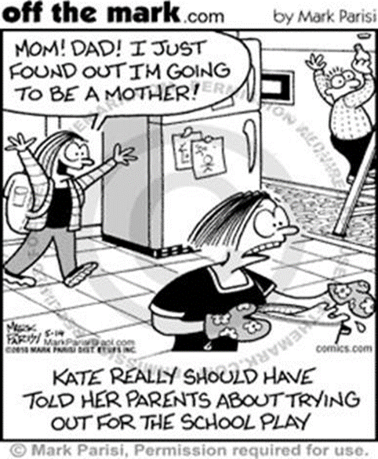
Clarity
Clarity implies emphasizing on a specific message or goal at a time, rather than trying to achieve too much at once.
Clarity in writing is established when the reader is aware of the author’s statement/purpose.

Slide 9
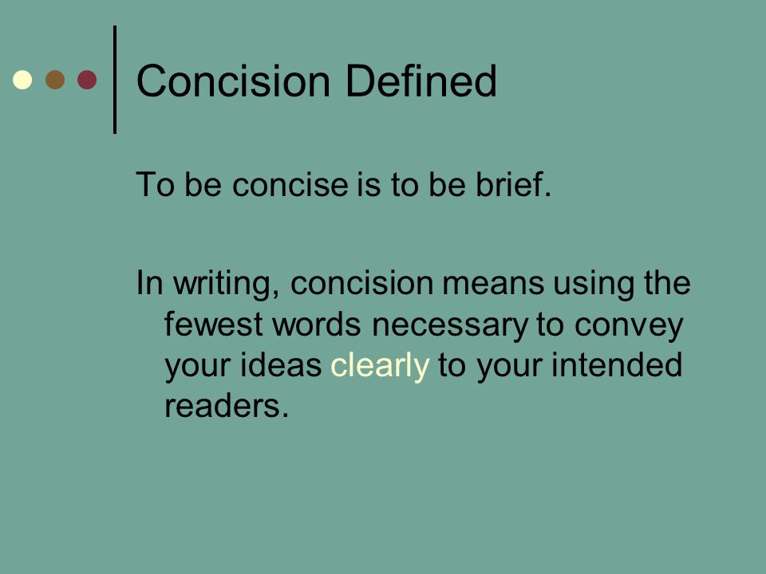
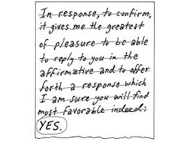
Concision
Notes:
One common problem in writing is the usage of too many words to express meanings.
This is called wordiness and its opposite is conciseness or concision.
Concise writing is direct and to the point.

Slide 10
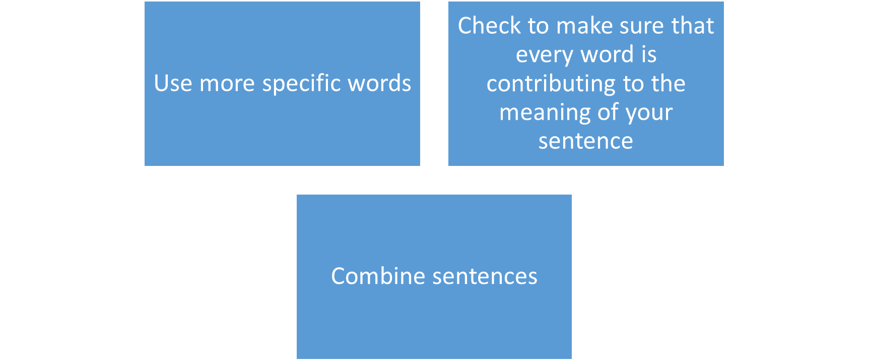
Concision
It is very important to be concise because :
The longer your text is, the less likely people are to read it
The wordier your text is, the more likely it is to confuse your readers
Notes:
Successful professional writing should help the reader understand the text, not present challenges to understanding.

Slide 11
Practice 1: Revise these sentences to state their meaning in fewer words.
1. He dropped out of school on account of the fact that it was necessary for him to help support his family.
2. It is being anticipated and expected that the new schedule will be announced and informed by the bus company by next Tuesday.
3. There are many ways in which a student who is interested in meeting foreign students may come to know one.

Slide 12
Answer
1. He dropped out of school on account of the fact that it was necessary for him to help support his family.
He dropped out of school to support his family.
2. It is being anticipated and expected that the new schedule will be announced and informed by the bus company by next Tuesday.
The bus company will probably announce its schedule by next Tuesday.
3. There are many ways in which a student who is interested in meeting foreign students may come to know one.
Any student who wants to meet foreign students can do so in many ways.

Slide 13
Coherence
Coherence is achieved when sentences and ideas are connected and flow together smoothly (in a paragraph).
Coherence is a state or situation in which all the parts or ideas fit together well, so that they form a united whole.
Coherence allows the reader to move easily throughout the text from one idea to the next, from one sentence to the next, and from one paragraph to the next.
Notes:
Coherence –in a paragraph
Continuity- Between Paragraphs

Slide 14
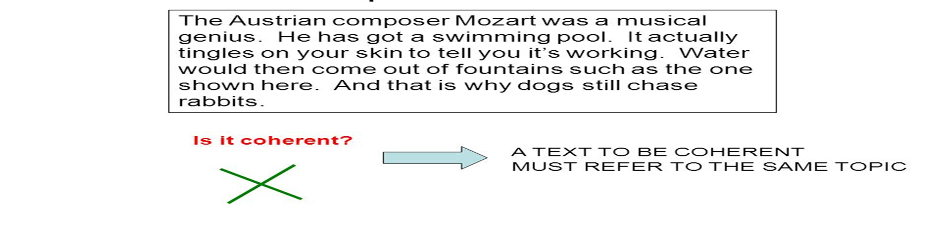

Slide 15
Continuity
Continuity:
You need to connect your thoughts from sentence to sentence in order to stay on topic. There are three ways to do so:
Transitional phrases ("on the other hand," "not only...but also")
Conjunctions, (as if, but, yet, while)
Keywords (repeat words and phrases from the past sentence in the following sentence).
Paragraph Transitions:
You need to connect your thoughts from paragraph to paragraph with your topic sentence. Basically, you use the same tools that you employ for sentence continuity, but instead of staying on topic, you are switching to a new topic.

